Slide 1
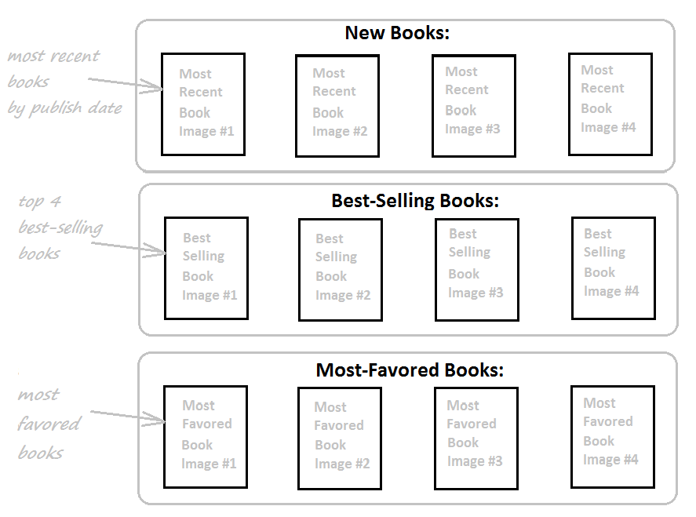
Complete Website Home Page

Slide 2
Complete Website Home Page
Best-Selling Books:
Books are sold the most
→ Books have the biggest number of copies (quantity) – reflected in order details
Most-Favored Books:
Books have average rating >= 4.0
Books have the most number of reviews

Slide 3
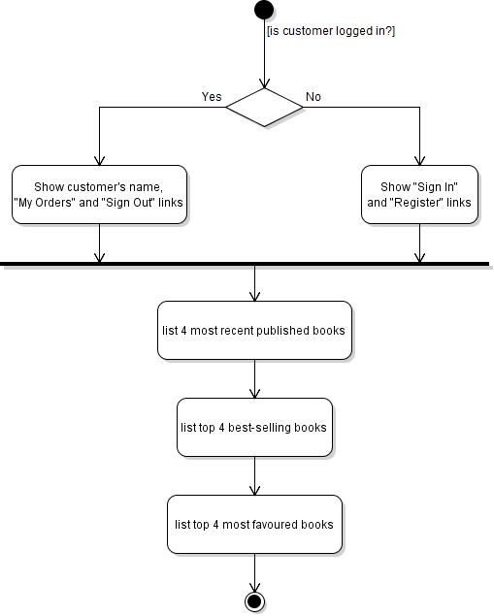
Activity Diagram: List Books in Home Page

Slide 4
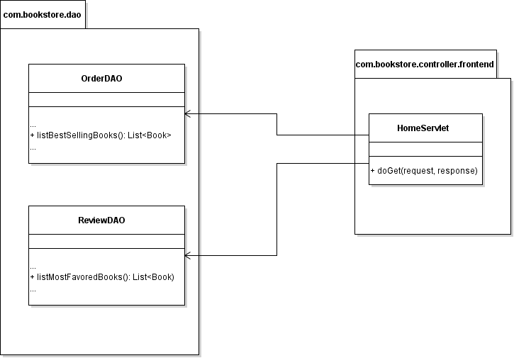
Class Diagram

Slide 5
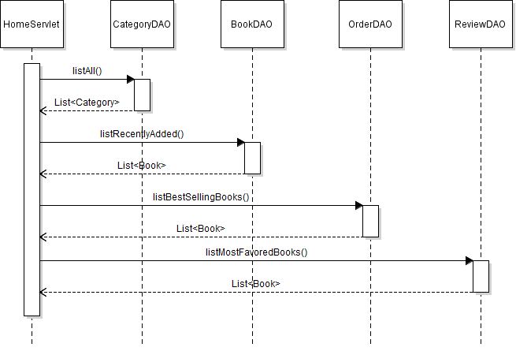
Sequence Diagram: List Books in Home Page

